Slide 2
Bose Connected Music
Cloud Infrastructure, Team, Strategy
Josh West <josh_west@bose.com>
Cloud Architect
Home Entertainment Division

Slide 3
Bose Connected Music Project
Home Entertainment Division
Research and Advanced Development
Product Owner & Manager: Keith Martin
Algorithms and Cloud Experience

Slide 4
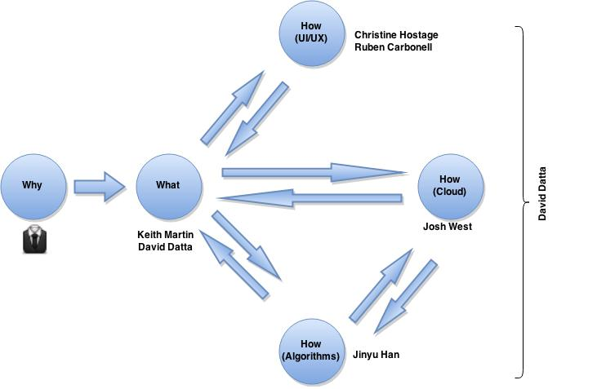
ACE Organization
Notes:
- Why:
- Better music experience for customers
- Increase/diversify product portfolio
- Make money!
- What:
- Smart recommendatoin engine
- Context aware
- Learn about our customers

Slide 5
How: Cloud
Strategy
DevOps Team
Cloud & App
Infrastructure

Slide 6
How : Cloud : Infrastructure
Introduction to Cloud Computing
Infrastructure as a Service
Amazon Web Services
Pioneered IaaS in 2006 (Xen)
Multiple cloud providers available today:
Microsoft Azure
Google Compute Engine
Rackspace Cloud, HP Helion, etc....

Slide 7
Jeff Bezos AWS Memo
All teams will henceforth expose their data and functionality through service interfaces.
Teams must communicate with each other through these interfaces.
There will be no other form of inter-process communication allowed: no direct linking, no direct reads of another team’s data store, no shared-memory model, no back-doors whatsoever. The only communication allowed is via service interface calls over the network.
It doesn’t matter what technology they use.
All service interfaces, without exception, must be designed from the ground up to be externalizable. That is to say, the team must plan and design to be able to expose the interface to developers in the outside world. No exceptions.
Anyone who doesn’t do this will be fired. Thank you; have a nice day!
Notes:
EVERYTHING AS A SERVICE!
This has lead us to the concept of 'microservices'

Slide 8
Amazon Web Services Concepts
Instance: virtual server
Region: collection of datacenters proximally located network is one fabric (connected)
Availability Zone: datacenter with a region
Billing: charged based on usage
Cpu time
Network traffic
Storage
Everything and anything...

Slide 9
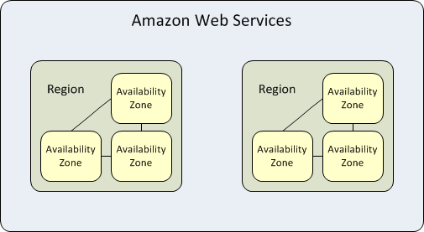
AWS Regions and Availabilty Zones

Slide 10
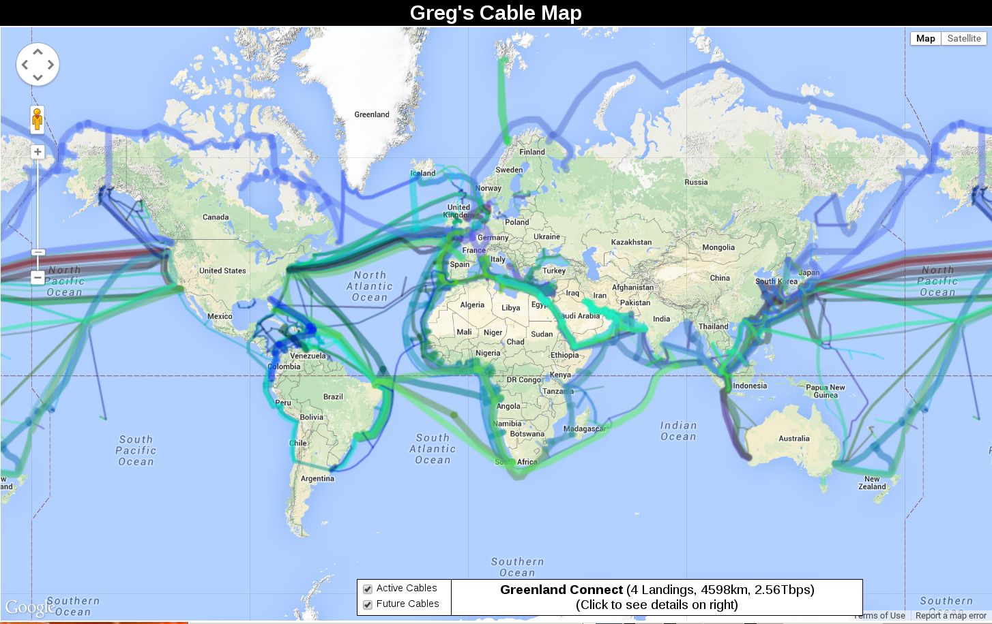
Notes:
- Latency from points across the world can easily be 200ms+
- this is a problem. This is a bad experience.
- Could build datacenters around the world, and then start building BCM system … but hat is a very big CapEx
- IaaS lets us rent capacity around the world without the massive CapEx
- IaaS is much more expensive in the long run but much cheaper (and quicker) in the short term

Slide 11
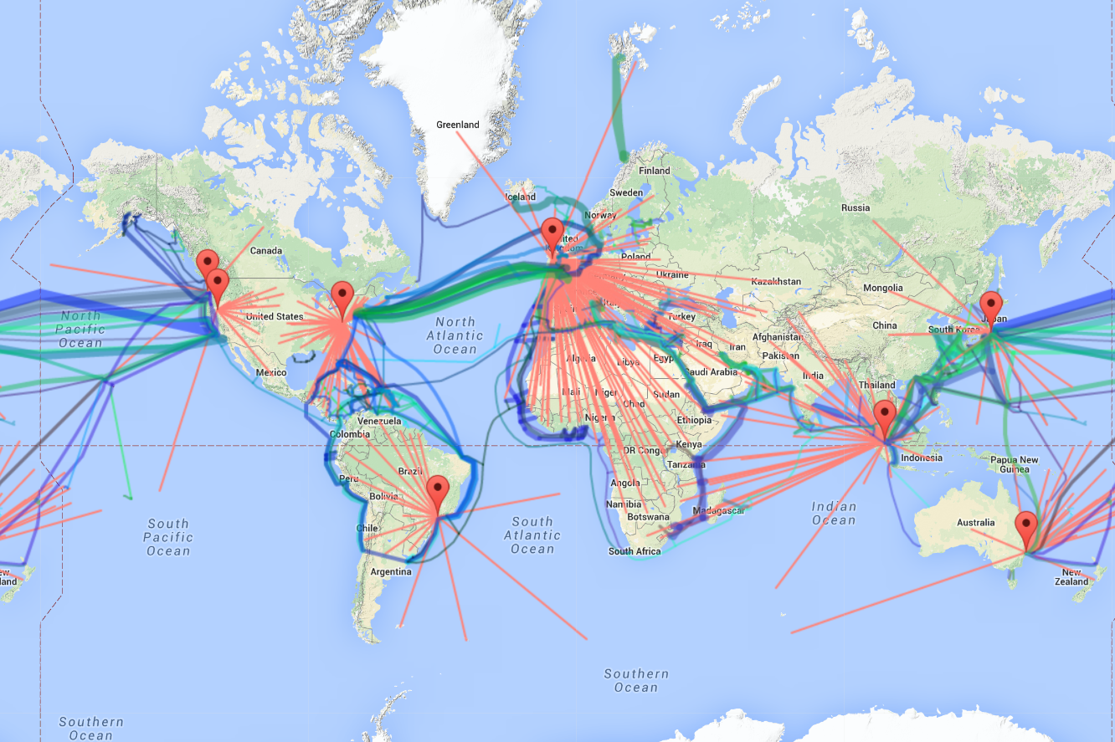

Slide 12
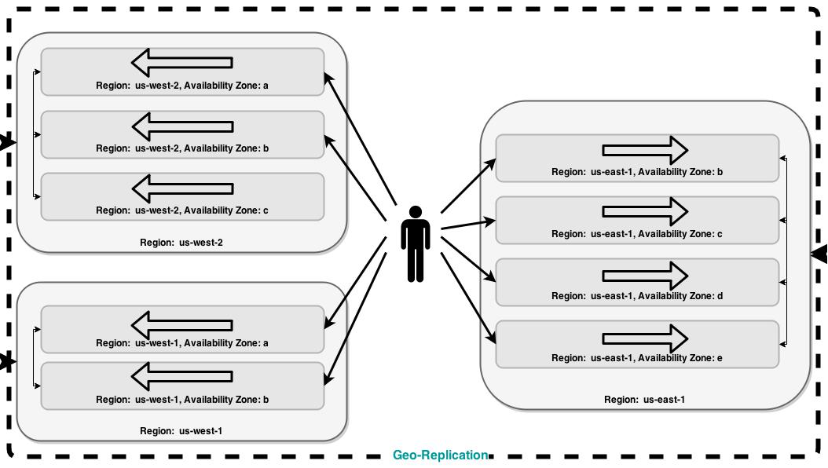

Slide 13
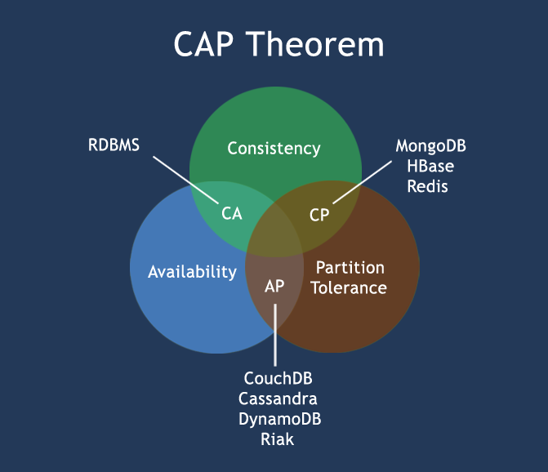
Notes:
In 2000, Eric Brewer conjectured that a distributed system cannot simultaneously provide all three of the following desirable properties:
Consistency: A read sees all previously completed writes.
Availability: Reads and writes always succeed.
Partition tolerance: Guaranteed properties are maintained even when network failures prevent some machines from communicating with others.

Slide 14
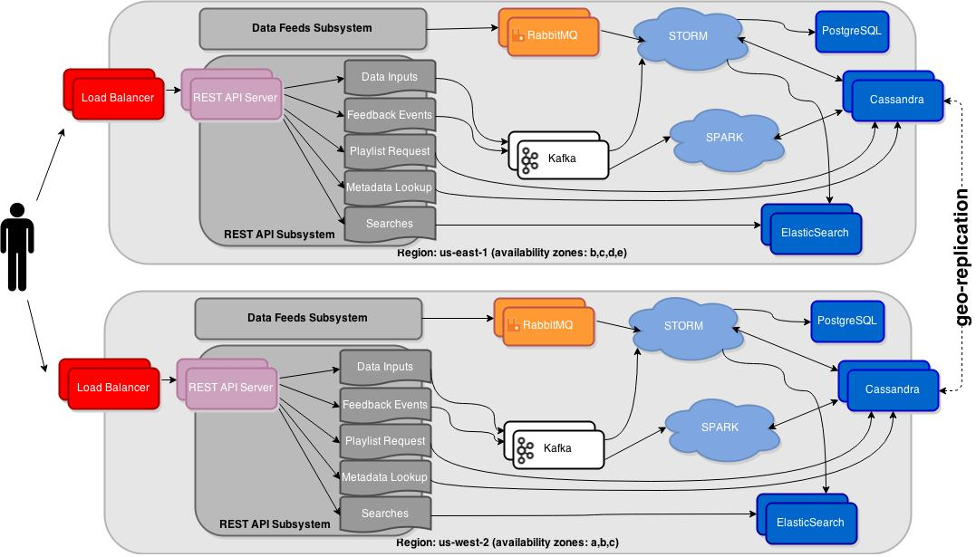

Slide 15
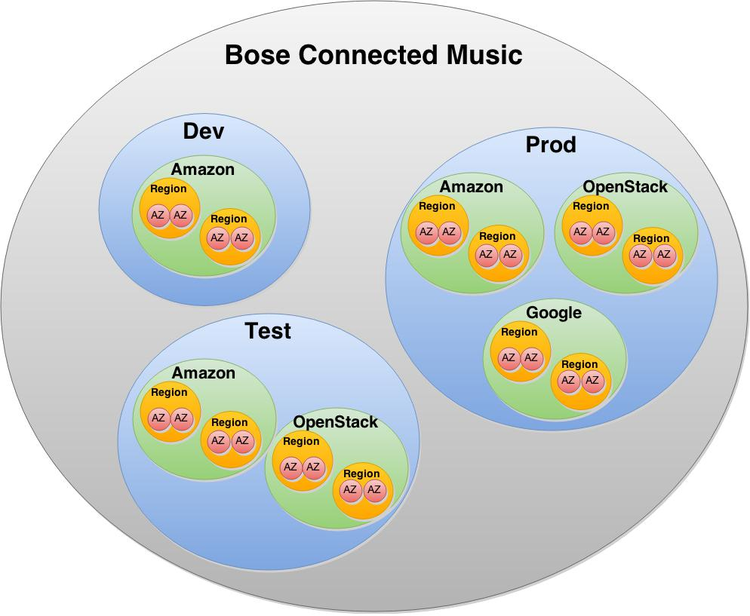

Slide 16
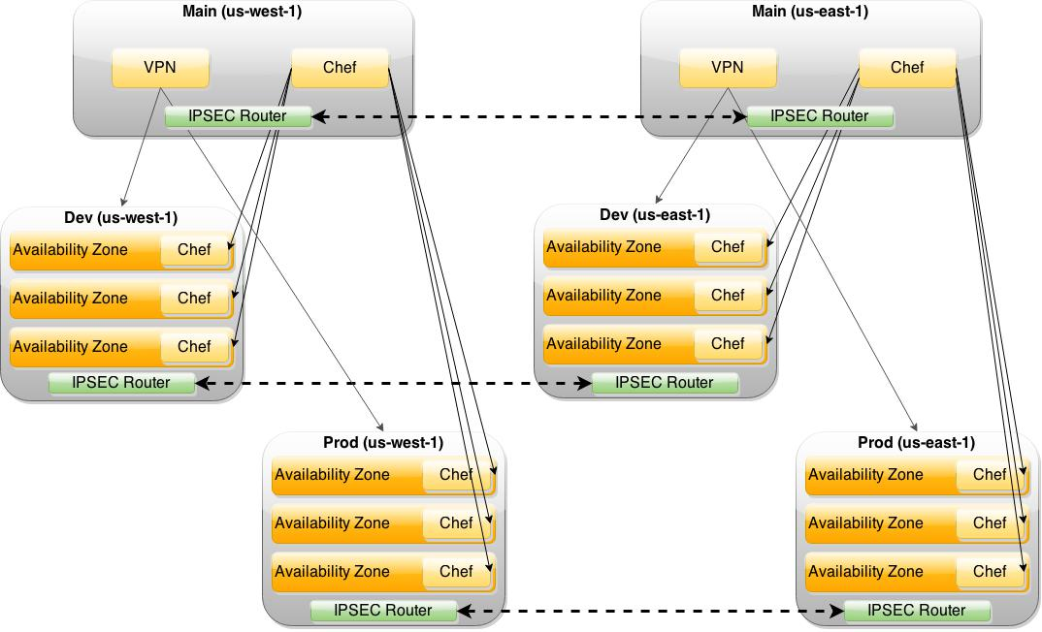

Slide 17
How: Cloud
Strategy
DevOps Team
Cloud & App
Infrastructure

Slide 18
How : Cloud : Team
People!
We are hiring!
Looking for Cassandra, NoSQL, big data, cloud engineering, high availability rockstars!
Looking for machine learning experts!
Notes:
- Making our way through software which will support the team.

Slide 19
How: Cloud
Strategy
DevOps Team
Cloud & App
Infrastructure

Slide 20
Cloud Strategy
Enable us to lower risk, tolerate failures
Enable us to be cost/budget sensitive
Enable us to be flexible and portable
Let us build for global scale (and domination)
Strike balance between Not/Invented Here Syndrome
Open to the future; open to constant change
Notes:
Must think about the future. Must build for the future, whatever that may be. Stay 3 steps ahead!
Not just solving the problem at hand right this moment right now!

Slide 21
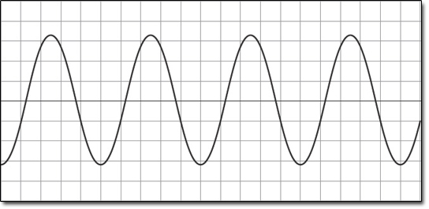
(Not) Invented Here Syndrome
With invent of {I,P,M,S}aaS, now seeing IHS
Vendor and solution lock-in
Great for start-ups (few people, no time)
We are not a start-up (well, sorta).
We have the expertise to “Do It Right”™

Slide 22
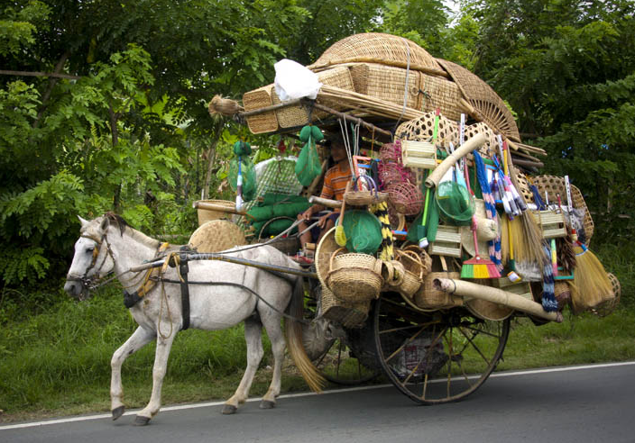
Strategy: Horizonal Scaling

Slide 23



Strategy: Infrastructure as Code
TERRAFORM
Fabric
Cloud Provisioning and Configuration
Server and Service Configuration
Data Loads and Sysadmin Tasks

Slide 24
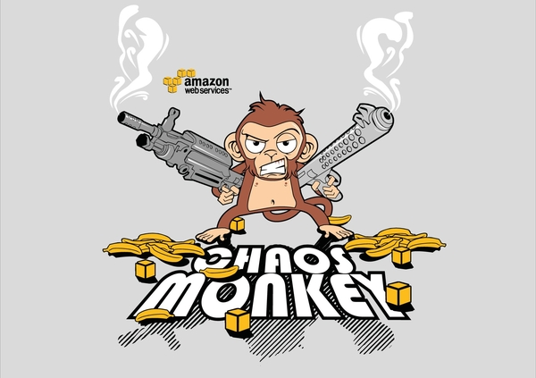
Strategy: Expect Failure!

Slide 25
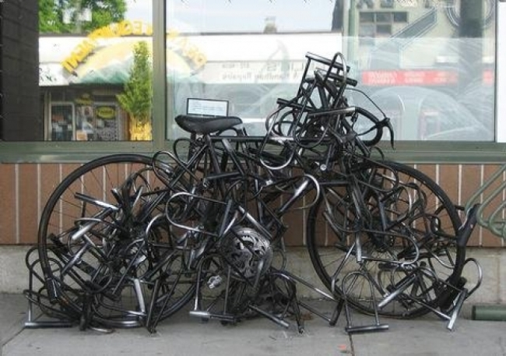
Strategy: Security
Notes:
Security is a process and not just something you tack on at the end
Must build security throughout entire stack
Data at rest, in use, in transit
Encryption, Auditing, Access Controls

Slide 26
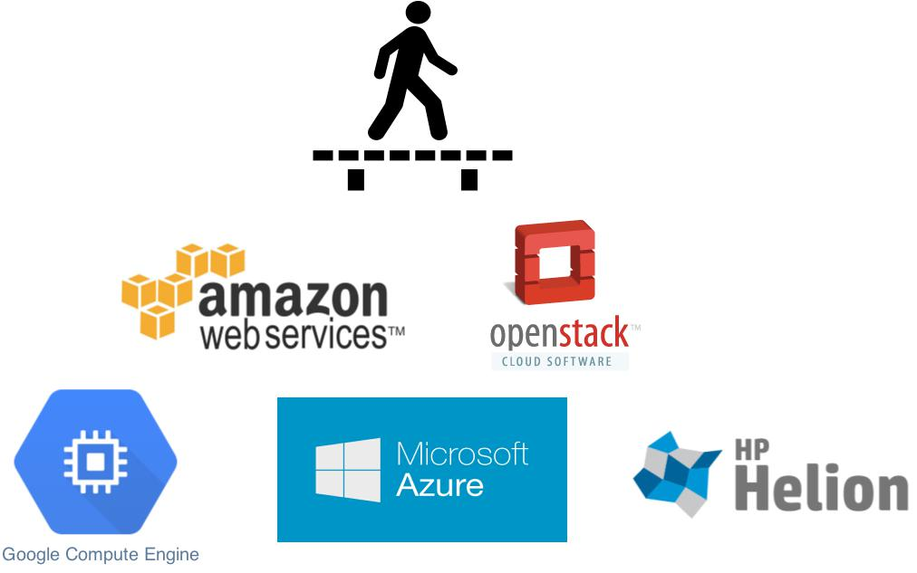
Strategy: Cross Cloud Provider (Hybrid)
Notes:
Cloud Strategy: Build across provider platforms
- Build cloud & app infrastructure to be portable
- Avoid vendor lockin, but find the right balance
- Nothing worse than a rigid infrastructure that cannot be modified without a full rebuild/redesign/redeploy.
- Not the times we live in anymore and we must remain flexible.
- Cloud landscape is in a boom. Rapidly evolving.
- Must remain open to change once the dust settles.

